Slide 1
OPCODER
Traffic Light System
Miguel Antonio Rodriguez Delgado
Marwa Mohammed Nabawey Hassan
Vincent Chinedu Obigwe
Abeeb Opeyemi Nureni
Charles Arsenal Okere
Amit Chakma

Slide 2
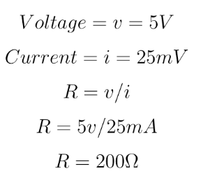
Basic Elements
Resistors
LEDs
Buttons

Slide 3
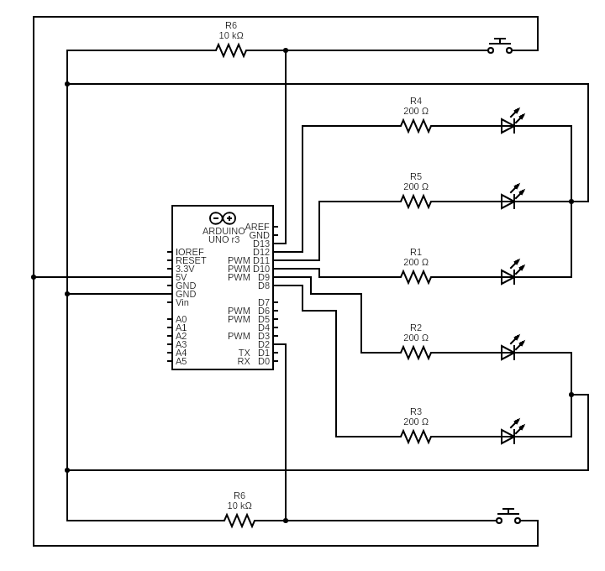
Electrical Circuit

Slide 4
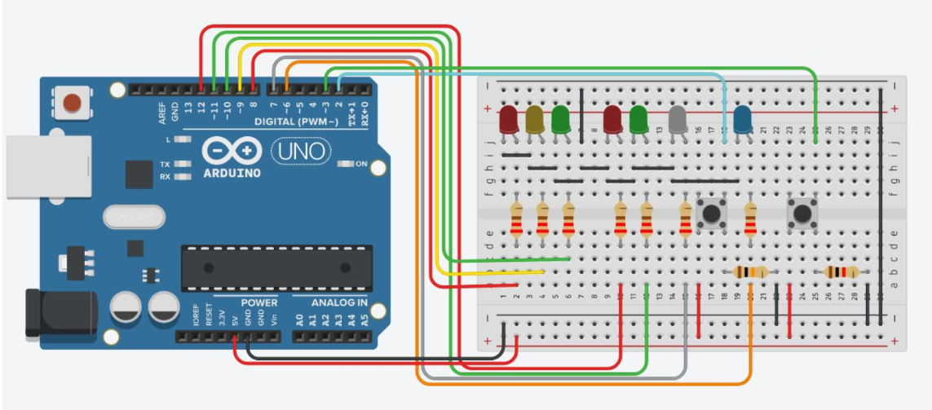
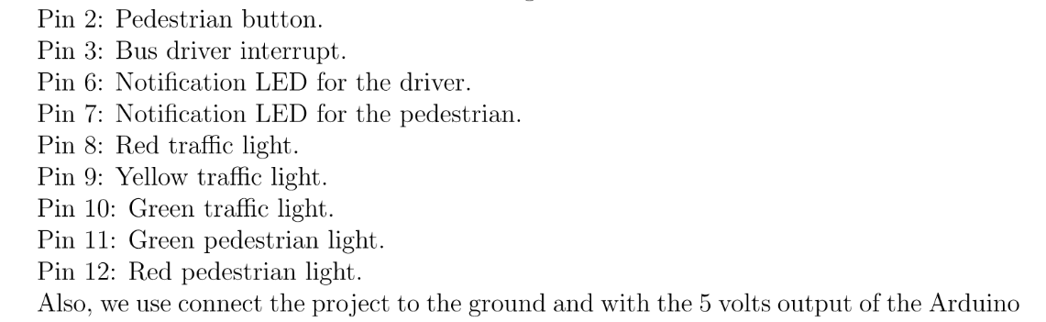
Arduino Circuit

Slide 5
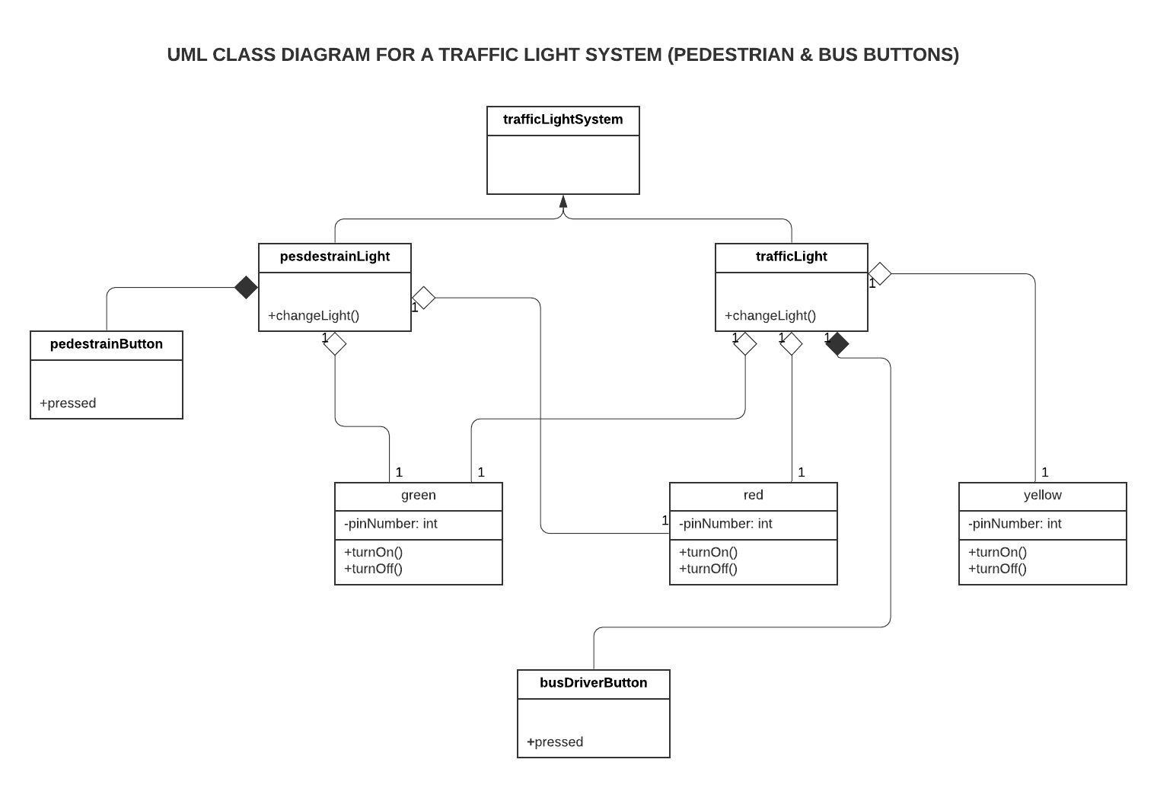
Class Diagram

Slide 6
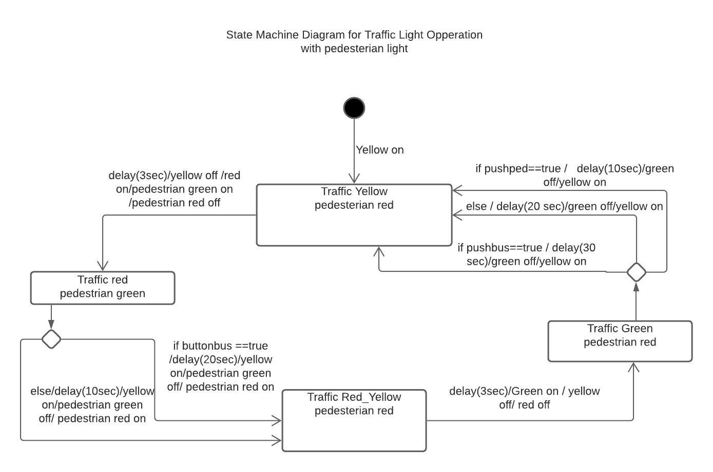
State Machine Diagram

Slide 7
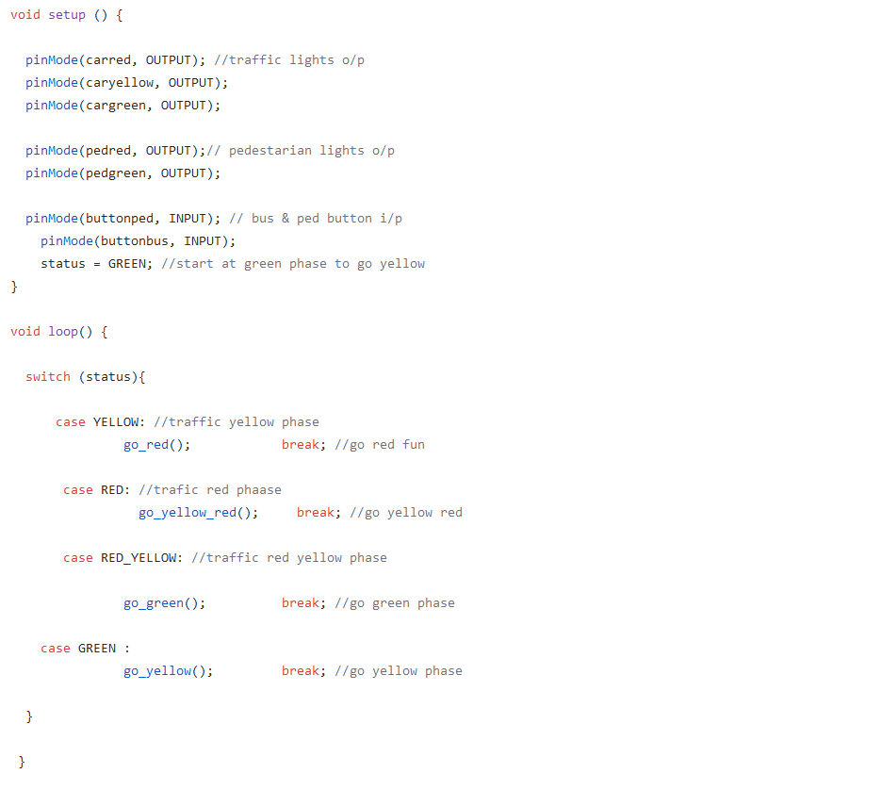
Coding Synchronous

Slide 8
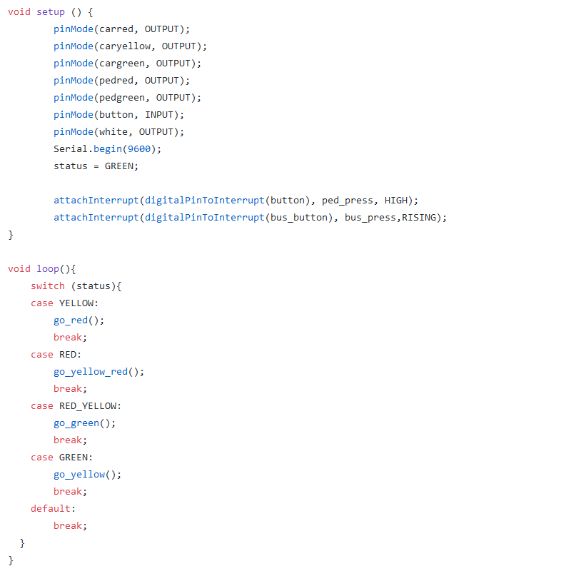
Coding Asynchronous

